Slide 1
Metals Dashboards and LG M48F Supply Plan Overview
Chiemi Kato
December 2019

Slide 2
Introduction
LG M48F Supply Plan
Metals Dashboards
LG Chem signed a contract to produce batteries for Tesla products at GF3 in late 2018.
Our team started working with LG Chem on this project ____
Challenges:
No framework for communication or operational analysis between Tesla and LG
We weren’t exactly sure how our vehicle production and sale would be impacted by LG’s production capacity
Sarah was using an excel-based dashboard that came with a long list of constraints
She asked for a transition to Power BI interface, which would allow for interactivity
Challenges:
Time inefficient
Not all the way functional tool

Slide 3
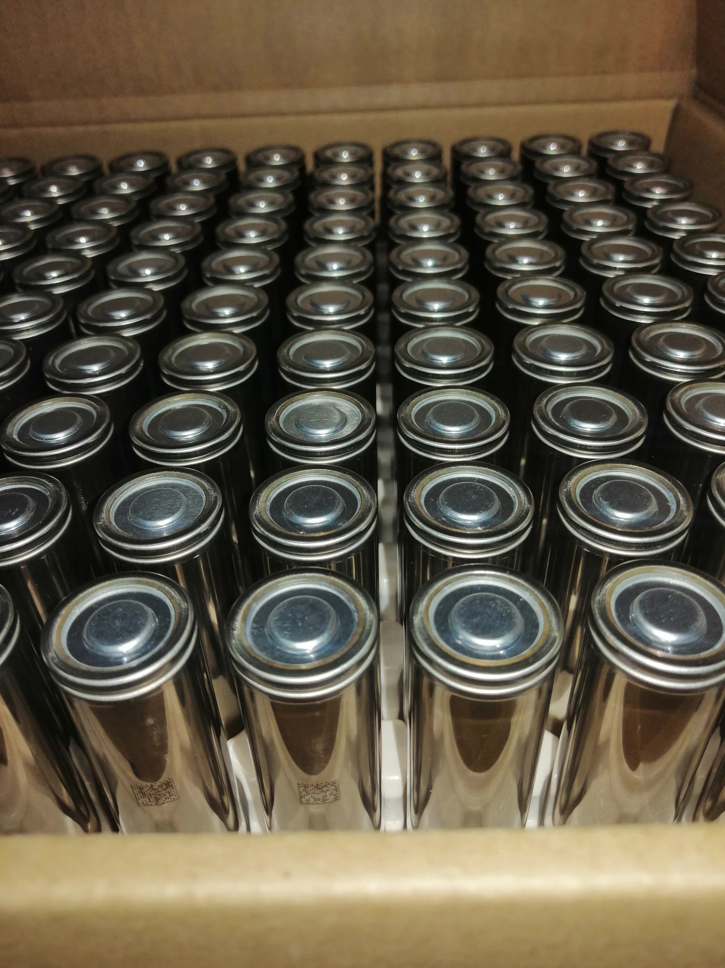
LG M48F Supply Plan Process/Improvements
Toggles to identify and simulate how supply will be impacted by design changes
Set up framework for LG to be able to provide more details (ie weekly production data and by assembly line)
Integrated/consolidated information from finance to provide different demand-side scenarios
Agreed with LG on a calendar formatting structure and also to pass the file back and forth to improve process
LG did the rest and I worked with them to improve and fix any errors from the new system

Slide 4
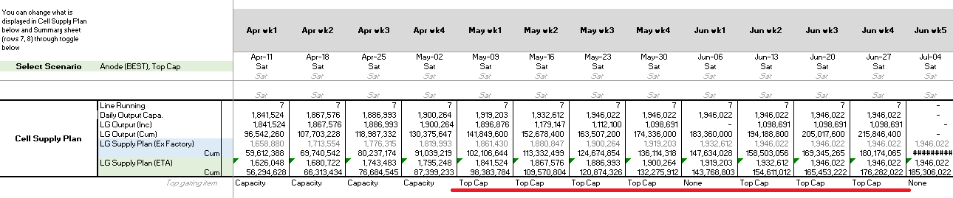
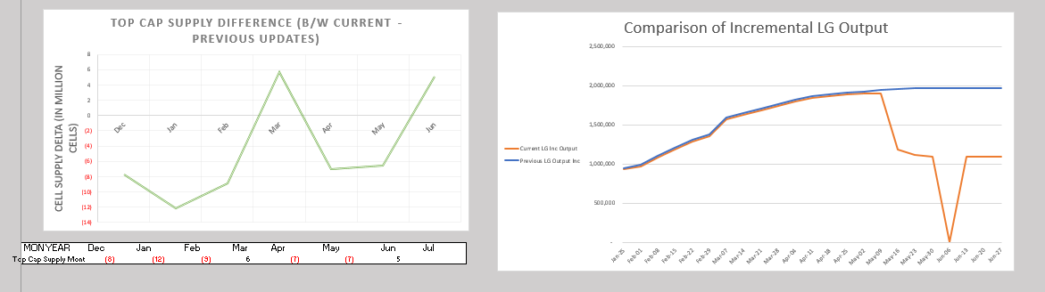

Slide 5
Outcome/Final Benefits
There is now a detailed framework and unified platform for teams to simulate and evaluate their own ideas
Improves interdepartmental and inter-company communication and understanding

Slide 6
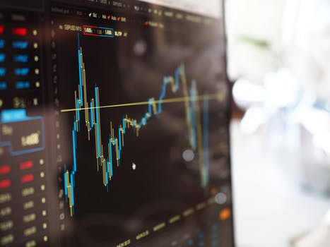


Metals Dashboards Process/Improvements
- Restructured the way source files were stored (SQLite database) so that visualizations would not be disrupted with data updates
- Used python to automate the data cleaning and transformations before loading to Power BI
- Utilized SharePoint/Power BI integration by hosting the visualization in SharePoint Battery GSM page

Slide 7
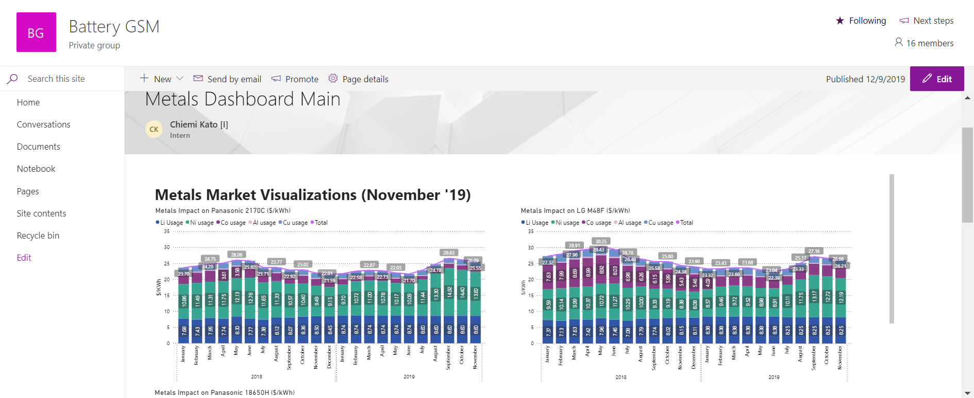
How to Access? Go to SharePoint Battery GSM page and click “Pages” tab to the left

Slide 8
Outcome/Final Benefits
Via seamless Power BI online and SharePoint integration, there is more room for collaboration by creating a
The interactive functionality of the Power BI dashboards allow for a deeper dive in to the details
All of the data automation is done within OneDrive cloud so that it can be completed by other team members as well
Increased time efficiency

Slide 9
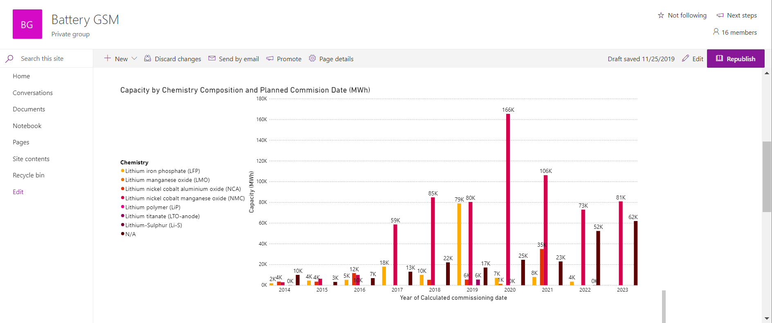
THE END!

Slide 10
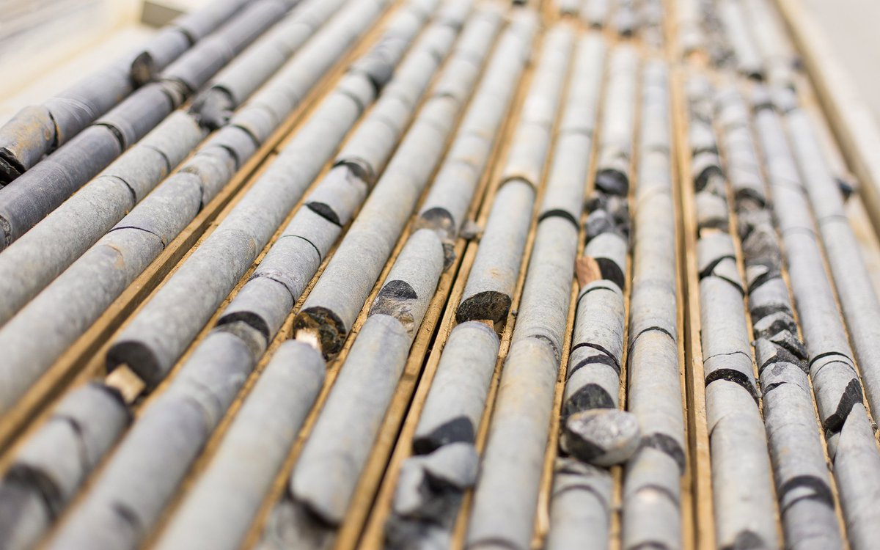
Nickel Price Forecasting Using Regression Process/Improvements/Benefits
- Model assumes serially correlated daily pricings (ie yesterday’s Nickel price has a relationship to today’s price)
-Automated data pipeline implements
- webscraping from LME website itself
- automated data cleaning/preprocessing (time reformatting for business days)
- automated parameter optimization through grid searching (matrix iterations)
- automated database updates that recreate the visualizations every time the model is run
-Provides an additional tool for Sarah and team to use alongside other tools to help make educated guesses to inform business strategy

Slide 12
Background & Challenges
Background: LG has been working with Tesla for around a decade on small volume battery operations like Powerwall
In late 2018 they signed a deal with Tesla for their first mass production assembly of battery products at Gigafactory 3
When I joined the project in September, I was assigned to work on the M48F supply ramp up plan there were many things to be improved -- really was no framework for how we were to communicate and collaborate with LG on a PRODUCTION LEVEL
At that time, we were provided with limited monthly information about cell supply and component capacity
CHALLENGE: There was no framework for communication or operational analysis between Tesla and LG and we weren’t exactly sure how our vehicle production and sale would be impacted by LG’s production capacity

Slide 13
3. Outcome – What is the improvement -DEMO
Show toggles…and walk through the PIPELINE of how information gets filtered into SUMMARY page
How I taught myself the operations by learning from the excel file (EXAMPLES)
I was able to gather information from different sides of the production to create detailed SP for other teams to understand and use as tools to simulate their own ideas

Slide 14
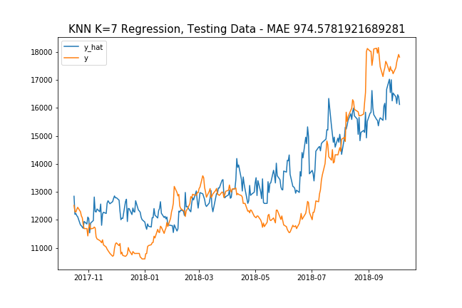
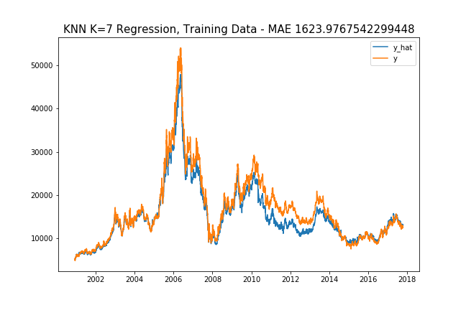
Demo – Web Scrape

